Slide 1
Idea/Approach Details
Ministry Category: Ministry of Electronics and Information Technology (MEITY)
Problem Statement Code: PK855
Problem Statement: Cyber Hygiene for Students
Team Leader Name: Shaikh Faizal Mashaq
Team Name: Team Dominators
Idea Description:
Hacking Simulation Game which will integrate the cyber hygiene in the young minds in an interactive way.
Game will contain the real life problems and the ways to solve them.
Different ways to tackle the cyber attacks and become Cyber Safe.
Major integration of Crowdsourcing Network which will allow player to interact with others facing the same problem.
The Crowdsourcing Network will also help in tackling the real threats and to report them to Cyber Crime.

Slide 2
Benefits to individuals:
The game will provide solutions for real life cyber threats.
This will improve the cyber hygiene in youths.
Our solution will bring more power in the IT security system.
This will make the youth cyber aware.
The cyber network will provide real-time interaction with co-players.
Daily Cyber news will be posted in the interactive format in the cyber network.
Impressive Defense mode with newest methods to tackle the threats.

Slide 3
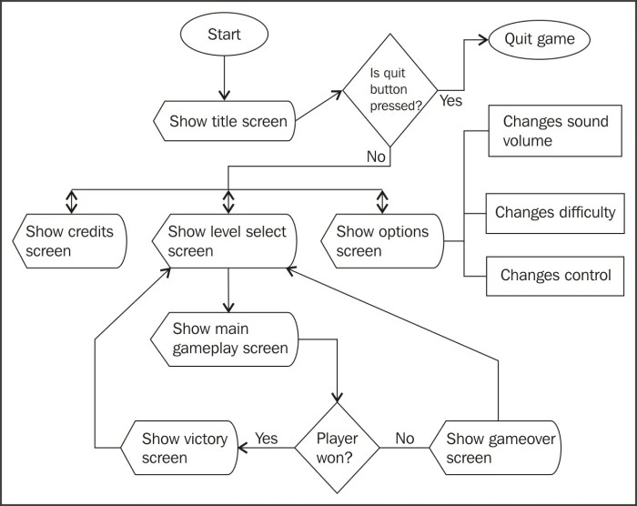
Game Flow Chart.

Slide 4

Game System
User Enters the game
Welcome screen
Level-01
Level-02

Slide 5
Cyber Network
Got stuck in a level?
Yes
No
Share your problem
Help others to solve
Make a community
Share your real life Cyber Problems

Slide 6
